Slide 1

Understanding Web Content

Slide 2
Content
In this lecture you’ll learn about:
How to understand the basics of HTML;
HTML elements;
The DOM Tree.

Slide 3
HTML Basics
1

Slide 4
HTML Basics
HyperText Markup Language (HTML) is a language for creating web pages and web applications. HTML special instructions are the building blocks of web pages.

Slide 5
HTML: General Structure
Document
HTML “itself”
<!DOCTYPE html>
<html>
<head>
<title>My first document</title>
<meta charset="UTF-8">
</head>
<body>
...
</body>
</html>

Slide 6
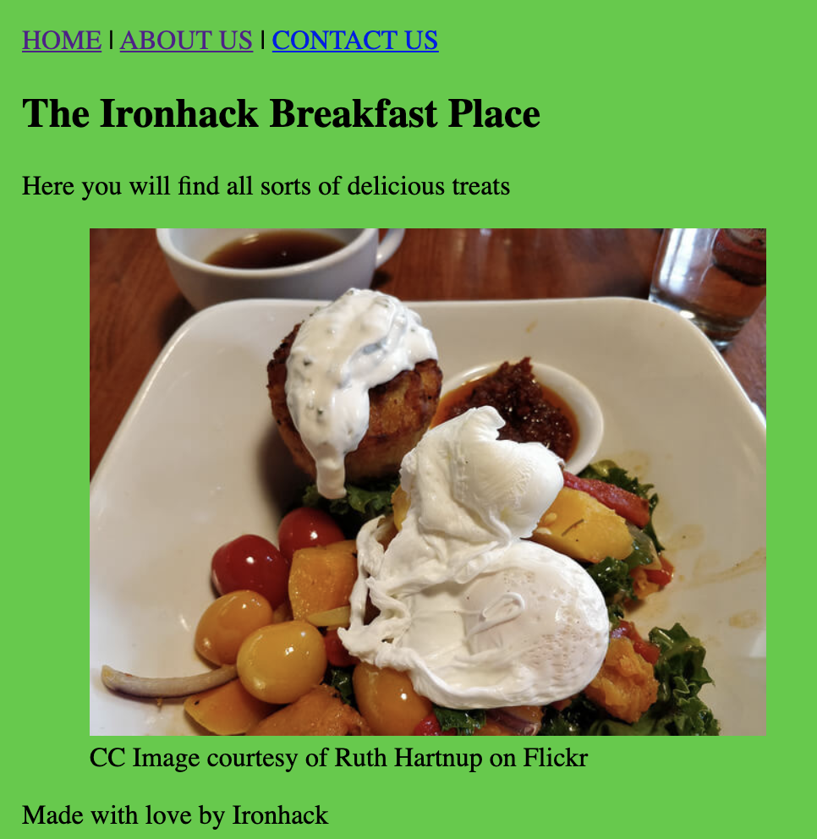
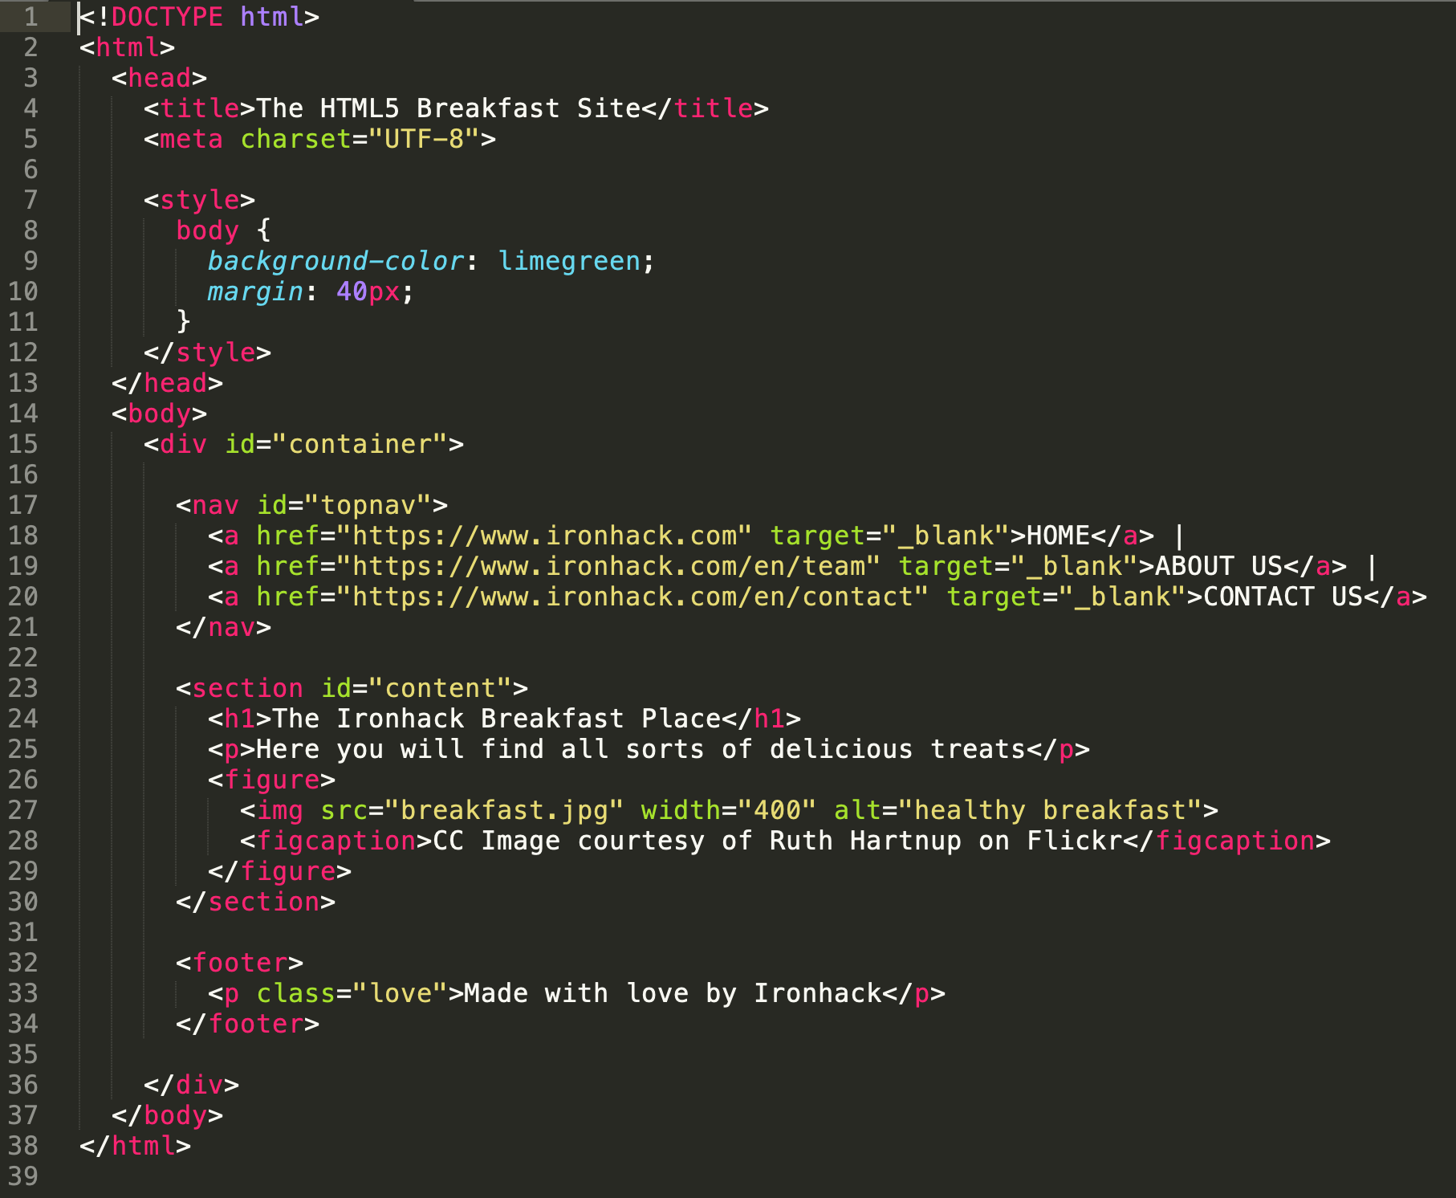
HTML Basics

Slide 7
HTML: Elements
2

Slide 8
HTML Elements: Introduction
An HTML element denotes a specific subdivision or component of the HTML file. It always consists of a start tag and an end tag. In between the tags, there is the content. The general structure of an element would be as follows:
<tag>[Hello World!]<\tag>
However, HTML elements are almost always nested. This would look like the following:
<main tag>
<tag>[Hello World!]<\tag>
<\main tag>

Slide 9
HTML Elements: Attributes
Also note that elements often contain additional attributes. For instance, a ‘clean’ element would be:
<tag>[Hello World!]<\tag>
However, if we want to convert this to a hyperlink, we require an additional attribute:
<tag> href=www.ironhack.com>[Hello World!]<\tag>
An attribute is simply an additional parameter that specifies how the information within a element should be displayed.

Slide 10
HTML Elements: <p> and <h>
Paragraphs: The HTML <p> element represents a paragraph of text. Paragraphs are blocks of text separated from adjacent blocks by vertical blank space and/or first-line indentation.
Headers: Heading elements have six levels of document headings (titles): <h1> is the most important and <h6> is the least important one. A title briefly describes the topic of the section it introduces.

Slide 11
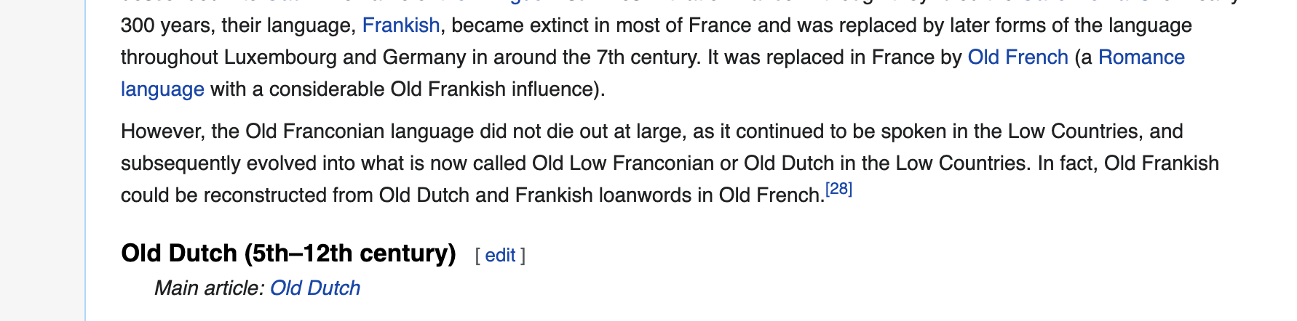
HTML Elements: <p> and <h>
<p>
However, the Old Franconian language did not die out at large, as it continued to be spoken in the Low Countries, and subsequently evolved into what is now called Old Low Franconian or Old Dutch in the Low Countries. In fact, Old Frankish could be reconstructed from Old Dutch and Frankish loanwords in Old French.<sup id="cite_ref-38" class="reference"><a href="#cite_note-38">&#91;28&#93;</a></sup>
</p>

Slide 12
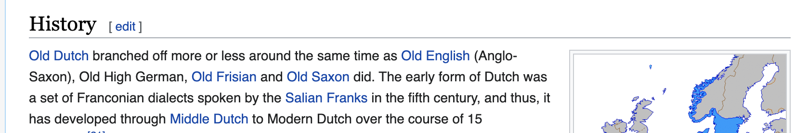
HTML Elements: <p> and <h>
<h2>
<span class="mw-headline" id="History">History</span><span class="mw-editsection"><span class="mw-editsection-bracket">[</span><a href="/w/index.php?title=Dutch_language&amp;action=edit&amp;section=2" title="Edit section: History">edit</a><span class="mw-editsection-bracket">]</span></span>
</h2>

Slide 13
HTML Elements: <ul> and <li>
Ordered List: The HTML <ol> element represents an ordered list of items. Each list item is numbered.
Unordered List: The <ul> element represents a list of items too. However, the order of items is not relevant.
Ordered and unordered lists both have elements within them. These elements are declared as li elements.
This would be an example of code for an ordered list:
<ol>
<li>first item</li>
<li>second item</li>
<li>third item</li>
</ol>

Slide 14
HTML Elements: <table>
Table: Used to express information in a two dimensional data table. It requires several other elements inside to make sense.
The HTML element table row <tr> defines a row of cells in a table. If the element inside a row defines a header, we should use the <th> (table header), otherwise we should use the <td> (table data).

Slide 15
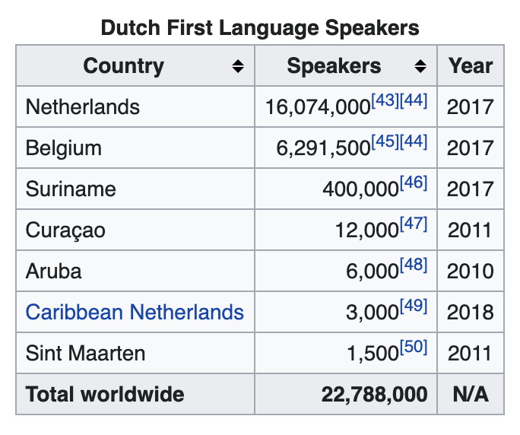
HTML Elements: <table>
<table class="wikitable sortable floatright" style="margin-left:1em">
<caption>Dutch First Language Speakers
</caption>
<tbody><tr>
<th>Country
</th>
<th>Speakers
</th>
<th class="unsortable">Year
</th></tr>
<tr>
<td>Netherlands
</td>
....

Slide 16
HTML Elements: <form>
Form: The <form> element is a section that allows the user to input information on a page. The <form> element holds inputs, radio buttons, select boxes, etc. Usually we will send this information to a web server.

Slide 17
HTML Elements: <form>
Forms are elements created to allow users to send information to the website's server. When a user does this, it is known as a POST Request (as in the user posts information).

Slide 18
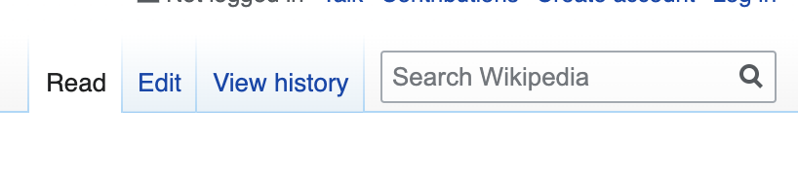
HTML Elements: <form> attributes
<form action="/w/index.php" id="searchform">
<div id="simpleSearch">
<input type="search" name="search" placeholder="Search Wikipedia" title="Search Wikipedia [f]" accesskey="f" id="searchInput"/>
<input type="hidden" name="title" value="Special:Search">
<input type="submit" name="fulltext" value="Search" title="Search Wikipedia for this text" id="mw-searchButton" class="searchButton mw-fallbackSearchButton"/>
<input type="submit" name="go" value="Go" title="Go to a page with this exact name if it exists" id="searchButton" class="searchButton"/>
</div>
</form>

Slide 19
HTML DOM Tree
3

Slide 20

HTML DOM Tree

Slide 21
Summary
4

Slide 22
Summary
In this lecture we learnt:
How to understand the basics of HTML;
HTML elements;
How to interpret HTML structures;
The DOM Tree.

Slide 23
Finis.
5

Slide 24
Appendix: HTML Elements: <fieldset>
The HTML <fieldset> element is used to group several forms into one within a web form.
We would need to group elements inside a form for different reasons: style purposes, organization and web accessibility features.
<form action="/action_page.php">
<fieldset>
<legend>Personalia:</legend>
<label for="fname">First name:</label>
<input type="text" id="fname" name="fname"><br><br>
<label for="lname">Last name:</label>
<input type="text" id="lname" name="lname"><br><br>
<label for="email">Email:</label>
<input type="email" id="email" name="email"><br><br>
<input type="submit" value="Submit">
</fieldset>
</form>

Slide 25
Appendix: Types of Web Content
Name | MIME Type | Common Extension | What it does/contains?
HTML | text/html | htm/html | HTML defines the structure of a webpage.
Image | image/* | Jpeg, gif etc. | Webpage’s visuals
Video Media | video/* | Mp4, ogg etc. | Sequences of img.
CSS | text/css | css | Cascading Style Sheet (how style of page is presented to user)
Application | application/* | Json, xml, pdf | Usually require software extensions
JavaScript | text/javascript | js | Makes page dynamic and interactive

Slide 26
Appendix: Types of Web Content
Multipurpose Internet Mail Extensions (MIME) is an internet standard originally designed for emails to support different types of web media. Later, the Internet communication protocols including HTTP and HTTPS also adopted MIME. It extends the email (and web) format beyond simple textual encoded data so that other types of data such as visual and audio data will also be supported.

Slide 27
Appendix: HTML DOM Tree
<!DOCTYPE html>: DOCTYPE Indicates that the markup language for your document content is HTML5.
<html>: html represents the root of an HTML document. All other elements must be descendants of this element. It is mandatory to close the tag at the very end of the document by typing </html>.
<head>: head defines an element that provides general information (metadata) about the document, including its title and links to its scripts and style sheets. Usually it contains:
<title>: Defines the title of the document, there's only one title element in the head element of an HTML. This title contains only text and it is shown in a browser's title bar or on the page's tab.
<meta>: Used to define metadata. This includes information about styles, scripts and data to help browsers use and render the page. One of the most commons elements is the <meta charset="UTF-8">. This specifies the character encoding for the HTML document as UTF-8.
<style>: Defines the CSS styles of the document. The CSS rules can be either (1) defined as a block in the <head> tag or (2) referenced from an external file.
<body>: body is the element containing all the content of an HTML document. Every HTML component should be written between the opening and the closing body tag. As there can be only one entire body in a document, there can be only one <body> element.

